Slide 1


LINKEDIN DATABASE PROJECT
Submitted by
Sanjay M
Althaf S
Rachana K
Manjunath T
Deekshitha A

Slide 2

What is Database?
A database is an organized collection of data, so that it can be easily accessed and managed.
You can organize data into tables, rows, columns, and index it, to make it easier to find relevant information.

Slide 3

What is LinkedIn?
LinkedIn is the world's largest professional network on the internet. Like Facebook, Instagram.
Why LinkedIn?
You can use LinkedIn to find the right job or internship, connect and strengthen professional relationships, and learn the skills you need to succeed in your career.
A complete LinkedIn profile can help you connect with opportunities by showcasing your unique professional story through experience, skills, and education.
You can also use LinkedIn to organize offline events, join groups, write articles, post photos and videos, and more.

Slide 4
Introduction
DB Name:- LinkedIn Database
In our database we are having seven Tables as follows,
Organization Table
Members Table
Groups Table
Members_groups Table
Connections Table
Posts Table
Member_Profile Table.

Slide 5
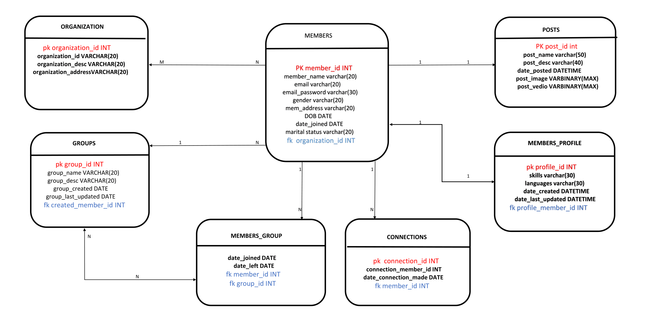
Class diagram of LinkedIn DB

Slide 6
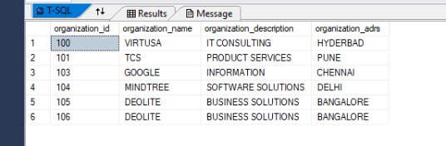
Organization table Overview
CREATE TABLE ORGANIZATION
(
ORGANIZATION_ID INT PRIMARY KEY,
ORGANIZATION_NAME VARCHAR(20),
ORGANIZATION_DESCRIPTION VARCHAR(20),
ORGANIZATION_ADRS VARCHAR(20)
);
INSERT INTO ORGANIZATION VALUES(100,'VIRTUSA','IT CONSULTING','HYDERBAD');
INSERT INTO ORGANIZATION VALUES(101,'TCS','PRODUCT SERVICES','PUNE');
INSERT INTO ORGANIZATION VALUES(103,'GOOGLE','INFORMATION','CHENNAI');
INSERT INTO ORGANIZATION VALUES(104,'MINDTREE','SOFTWARE SOLUTIONS','DELHI');
INSERT INTO ORGANIZATION VALUES(105,'DEOLITE','BUSINESS SOLUTIONS','BANGALORE');
INSERT INTO ORGANIZATION VALUES(106,'DEOLITE','BUSINESS SOLUTIONS','BANGALORE');
INSERTING VALUES
TABLE CREATION
TABLE RECORDS

Slide 7

Members table Overview
CREATE TABLE MEMBERS(
MEMBER_ID INT PRIMARY KEY,
MEMBER_NAME VARCHAR(20),
EMAIL VARCHAR(20),
EMAIL_PASSWORD VARCHAR(30),
GENDER VARCHAR(30),
MEM_ADDRESS VARCHAR(20),
DOB DATE,
DATE_JOINED DATE,
MARTIAL_STATUS VARCHAR(20),
ORGANIZATION_ID INT FOREIGN KEY REFERENCES ORGANIZATION(ORGANIZATION_ID));
INSERT INTO MEMBERS VALUES(1111,'MANJUNATH','MANJUNATH@GMAIL.COM','MANJA','MALE','BANGALOE','27-DEC-1997','03-MAY-2021','SINGLE',100);
INSERT INTO MEMBERS VALUES(2222,'ALTHAF','ALTHAF@GMAIL.COM','ALTHAF','MALE','BANGALORE','06-NOV-1997','05-MAY-2019','SINGLE',100);
INSERT INTO MEMBERS VALUES(3333,'RACHANA','RACHANA@GMAIL.COM','RACHANA','FEMALE','MANGALORE','15-DEC-1998','20-NOV-2020','SINGLE',101);
INSERT INTO MEMBERS VALUES(4444,'DEEKSHITHA','DEEKSHITHA@GMAIL.COM','DEEKSHITHA','FEMALE','KADAPA','21-JUL-1999','03-APR-2018','SINGLE',105);
INSERTING VALUES
TABLE CREATION
TABLE RECORDS

Slide 8
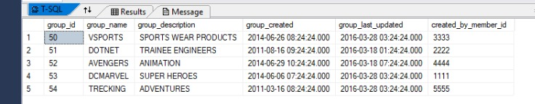
Groups table Overview
CREATE TABLE GROUPS(
GROUP_ID INT PRIMARY KEY,
GROUP_NAME VARCHAR(20),
GROUP_DESCRIPTION VARCHAR(20),
GROUP_CREATED DATETIME,
GROUP_LAST_UPDATED DATETIME,
CREATED_BY_MEMBER_ID INT FOREIGN KEY REFERENCES MEMBERS(MEMBER_ID));
INSERT INTO MEMBER_PROFILE VALUES(500,'JAVA & SQL','ENGLISH & KANNADA','19-JAN-2014 07:24:24:000','18-MAR-2016 03:24:24:000',1111);
INSERT INTO MEMBER_PROFILE VALUES(501,'DOT NET& JS','ENGLISH & TELUGU','16-JAN-2013 07:24:24:000','16-MAR-2016 03:24:24:000',2222);
INSERT INTO MEMBER_PROFILE VALUES(502,'UI & SQL','HINDI & KANNADA','09-JAN-2014 07:24:24:000','08-MAR-2016 17:24:24:000',3333);
INSERT INTO MEMBER_PROFILE VALUES(503,'JAVA & SQL','ENGLISH & KANNADA','09-JAN-2014 07:24:24:000','08-MAR-2016 03:24:24:000',4444);
INSERT INTO MEMBER_PROFILE VALUES(504,'PYTHON & MONGODB','TELUGU & KANNADA','19-JAN-2014 07:24:24:000','08-MAR-2016 03:24:24:000',4444);
TABLE CREATION
INSERTING VALUES
TABLE RECORDS

Slide 9
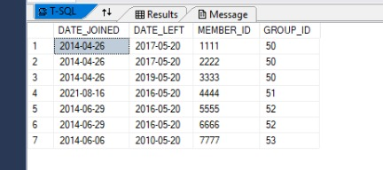
Members_Groups table Overview
CREATE TABLE MEMBERS_GROUPS
(
DATE_JOINED DATE,
DATE_LEFT DATE,
MEMBER_ID INT FOREIGN KEY REFERENCES MEMBERS(MEMBER_ID),
GROUP_ID INT FOREIGN KEY REFERENCES GROUPS(GROUP_ID)
);
INSERT INTO MEMBERS_GROUPS VALUES('26-APR-2014','20-MAY-2017',1111,50);
INSERT INTO MEMBERS_GROUPS VALUES('26-APR-2014','20-MAY-2017',2222,50);
INSERT INTO MEMBERS_GROUPS VALUES('26-APR-2014','20-MAY-2019',3333,50);
INSERT INTO MEMBERS_GROUPS VALUES('16-AUG-2021','20-MAY-2016',4444,51);
INSERT INTO MEMBERS_GROUPS VALUES('29-JUN-2014','20-MAY-2016',5555,52);
INSERT INTO MEMBERS_GROUPS VALUES('29-JUN-2014','20-MAY-2016',6666,52);
INSERT INTO MEMBERS_GROUPS VALUES('06-JUN-2014','20-MAY-2010',7777,53);
TABLE CREATION
INSERTING VALUES
TABLE RECORDS

Slide 10
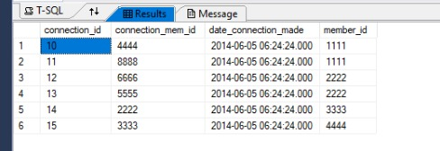
Connections table Overview
CREATE TABLE CONNECTIONS
(
CONNECTION_ID INT PRIMARY KEY,
CONNECTION_MEM_ID INT,
DATE_CONNECTION_MADE DATETIME,
MEMBER_ID INT FOREIGN KEY REFERENCES MEMBERS(MEMBER_ID)
);
INSERT INTO CONNECTIONS VALUES(10,2000,'20-MAY-2019',1111);
INSERT INTO CONNECTIONS VALUES(11,2001,'20-MAY-2019 11:44:44:000',1111);
INSERT INTO CONNECTIONS VALUES(12,2002,'20-JUL-2016 01:24:24:000',2222);
INSERT INTO CONNECTIONS VALUES(13,2003,'10-NOV-2016 10:44:44:000',2222);
INSERT INTO CONNECTIONS VALUES(14,2004,'10-JAN-2018 08:38:44:000',3333);
INSERT INTO CONNECTIONS VALUES(15,2005,'18-JUN-2014 07:24:04:000',4444);
TABLE CREATION
INSERTING VALUES
TABLE RECORDS

Slide 11
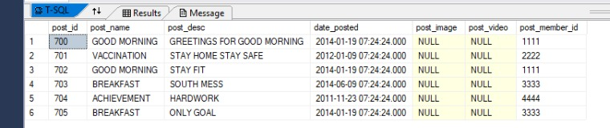
Posts table Overview
CREATE TABLE POSTS(
POST_ID INT PRIMARY KEY,
POST_NAME VARCHAR(50),
POST_DESC VARCHAR(40),
DATE_POSTED DATETIME,
POST_IMAGE VARBINARY(MAX),
POST_VIDEO VARBINARY(MAX),
POST_MEMBER_ID INT FOREIGN KEY REFERENCES MEMBERS(MEMBER_ID));
INSERT INTO POSTS(POST_ID,POST_NAME,POST_DESC,DATE_POSTED,POST_MEMBER_ID) VALUES(700,'GOOD MORNING','GREETINGS FOR GOOD MORNING','19-JAN-2014 07:24:24:000',1111);
INSERT INTO POSTS(POST_ID,POST_NAME,POST_DESC,DATE_POSTED,POST_MEMBER_ID) VALUES(701,'VACCINATION','STAY HOME STAY SAFE','09-JAN-2014 07:24:24:000',2222);
INSERT INTO POSTS(POST_ID,POST_NAME,POST_DESC,DATE_POSTED,POST_MEMBER_ID) VALUES(702,'PLAY BOLD','STAY FIT','19-JAN-2014 07:24:24:000',1111);
INSERT INTO POSTS(POST_ID,POST_NAME,POST_DESC,DATE_POSTED,POST_MEMBER_ID) VALUES(703,'BREAKFAST','SOUTH MESS','09-JUN-2014 07:24:24:000',3333);
INSERTING VALUES
TABLE CREATION
TABLE RECORDS

Slide 12
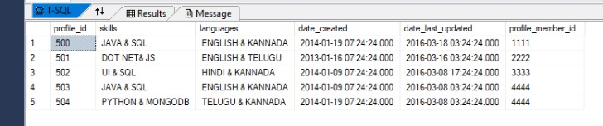
Members_Profile table Overview
CREATE TABLE MEMBER_PROFILE(
PROFILE_ID INT PRIMARY KEY,
SKILLS VARCHAR(30),
LANGUAGES VARCHAR(30),
DATE_CREATED DATETIME,
DATE_LAST_UPDATED DATETIME,
PROFILE_MEMBER_ID INT FOREIGN KEY REFERENCES MEMBERS(MEMBER_ID));
INSERT INTO MEMBER_PROFILE VALUES(500,'JAVA & SQL','ENGLISH & KANNADA','19-JAN-2014 07:24:24:000','18-MAR-2016 03:24:24:000',1111);
INSERT INTO MEMBER_PROFILE VALUES(501,'DOT NET& JS','ENGLISH & TELUGU','16-JAN-2013 07:24:24:000','16-MAR-2016 03:24:24:000',2222);
INSERT INTO MEMBER_PROFILE VALUES(502,'UI & SQL','HINDI & KANNADA','09-JAN-2014 07:24:24:000','08-MAR-2016 17:24:24:000',3333);
INSERTING VALUES
TABLE CREATION
TABLE RECORDS

Slide 13

Queries : 1 to 6 by SANJAY M
Members table

Slide 14
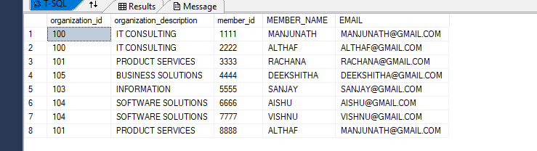
Queries : 1 to 6 -Sanjay
QUERY 1. WAQ TO DISPALY ORGANIZATION_ID,ORGANIZATION_DESCRIPTION,MEMBER_ID,MEMBER_NAME,EMAIL FROM ORGANIZATION & MEMBERS TABLES USING INNER JOIN.
QUERY :-
SELECT O.ORGANIZATION_ID,O.ORGANIZATION_DESCRIPTION,M.MEMBER_ID,M.MEMBER_NAME,M.EMAIL
FROM ORGANIZATION O INNER JOIN MEMBERS M ON O.ORGANIZATION_ID=M.ORGANIZATION_ID;
OUTPUT :-

Slide 15
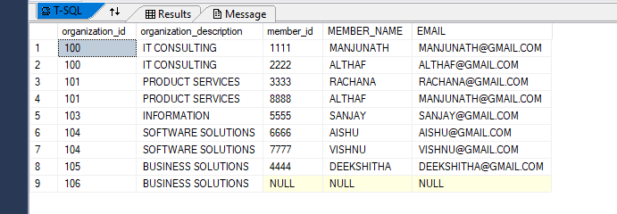
QUERY 2. WAQ TO DISPALY ORGANIZATION_ID,ORGANIZATION_DESCRIPTION,MEMBER_ID,MEMBER_NAME,EMAIL FROM ORGANIZATION & MEMBERS TABLES USING LEFT OUTER JOIN.
QUERY :-
SELECT O.ORGANIZATION_ID,O.ORGANIZATION_DESCRIPTION,M.MEMBER_ID,M.MEMBER_NAME,M.EMAIL
FROM ORGANIZATION O LEFT OUTER JOIN MEMBERS M ON O.ORGANIZATION_ID=M.ORGANIZATION_ID;
OUTPUT :-

Slide 16

QUERY 3. WAQ TO DISPALY ORGANIZATION_ID,ORGANIZATION_DESCRIPTION,MEMBER_ID,MEMBER_NAME,EMAIL FROM ORGANIZATION & MEMBERS TABLES USING RIGHT OUTER JOIN.
QUERY :-
SELECT O.ORGANIZATION_ID,O.ORGANIZATION_DESCRIPTION,M.MEMBER_ID,M.MEMBER_NAME,M.EMAIL
FROM ORGANIZATION O RIGHT OUTER JOIN MEMBERS M ON O.ORGANIZATION_ID=M.ORGANIZATION_ID;
OUTPUT :-

Slide 17
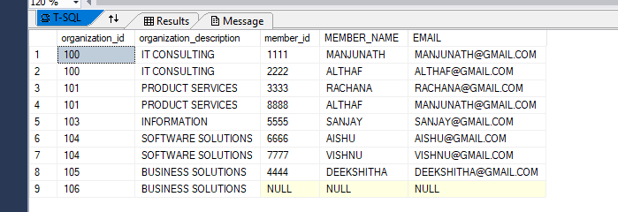
QUERY 4. WAQ TO DISPALY ORGANIZATION_ID,ORGANIZATION_DESCRIPTION,MEMBER_ID,MEMBER_NAME,EMAIL FROM ORGANIZATION & MEMBERS TABLES USING FULL OUTER JOIN.
QUERY :-
SELECT O.ORGANIZATION_ID,O.ORGANIZATION_DESCRIPTION,M.MEMBER_ID,M.MEMBER_NAME,M.EMAIL
FROM ORGANIZATION O FULL OUTER JOIN MEMBERS M ON O.ORGANIZATION_ID=M.ORGANIZATION_ID;
OUTPUT :-

Slide 18
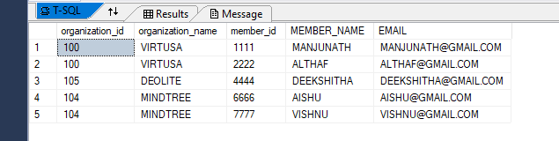
QUERY 5. WAQ TO DISPALY EMPLOYEE DETAILS WHO ARE WORKING FOR ORGANIZATION 100,104 AND 105.
QUERY :-
SELECT O.ORGANIZATION_ID,O.ORGANIZATION_NAME,M.MEMBER_ID,M.MEMBER_NAME,M.EMAIL
FROM ORGANIZATION O INNER JOIN MEMBERS M ON O.ORGANIZATION_ID=M.ORGANIZATION_ID
AND O.ORGANIZATION_ID IN(100,104,105);
OUTPUT :-

Slide 19
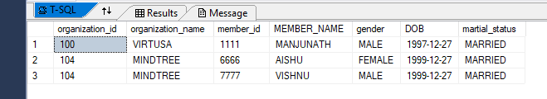
QUERY 6. WAQ TO DISPALY ORGANIZATION_ID,ORGANIZATION_NAME,MEMBER_ID,MEMBER_NAME WHO ARE MARRIED.
QUERY :-
SELECT O.ORGANIZATION_ID,O.ORGANIZATION_NAME,M.MEMBER_ID,M.MEMBER_NAME,M.GENDER,M.DOB,M.MARTIAL_STATUS
FROM ORGANIZATION O INNER JOIN MEMBERS M ON O.ORGANIZATION_ID=M.ORGANIZATION_ID
AND M.MARTIAL_STATUS='MARRIED';
OUTPUT :-

Slide 20
Queries : 7 to 12 by RACHANA K
Organization table

Slide 21
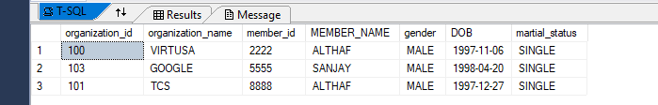
QUERY 7. WAQ TO DISPALY ORGANIZATION_ID,ORGANIZATION_NAME,MEMBER_ID,MEMBER_NAME, GENDER, DOB WHO ARE NOT MARRIED AND GENDER=MALE.
QUERY :-
SELECT O.ORGANIZATION_ID,O.ORGANIZATION_NAME,M.MEMBER_ID,M.MEMBER_NAME,M.GENDER,M.DOB,M.MARTIAL_STATUS
FROM ORGANIZATION O INNER JOIN MEMBERS M ON O.ORGANIZATION_ID=M.ORGANIZATION_ID
AND M.MARTIAL_STATUS='SINGLE' AND GENDER='MALE';
OUTPUT :-

Slide 22
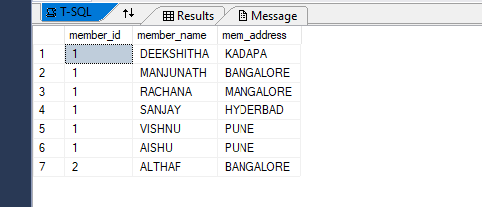
QUERY 8. WAQ TO DISPLAY THE DETAILS OF MEMBER USING GROUP BY CLAUSE AND MEMBER_ID’S IN ASCENDING ODER.
QUERY :-
SELECT COUNT(MEMBER_ID) AS MEMBER_ID,MEMBER_NAME,MEM_ADDRESS FROM MEMBERS
GROUP BY MEM_ADDRESS,MEMBER_NAME ORDER BY COUNT(MEMBER_ID) ASC;
OUTPUT :-

Slide 23
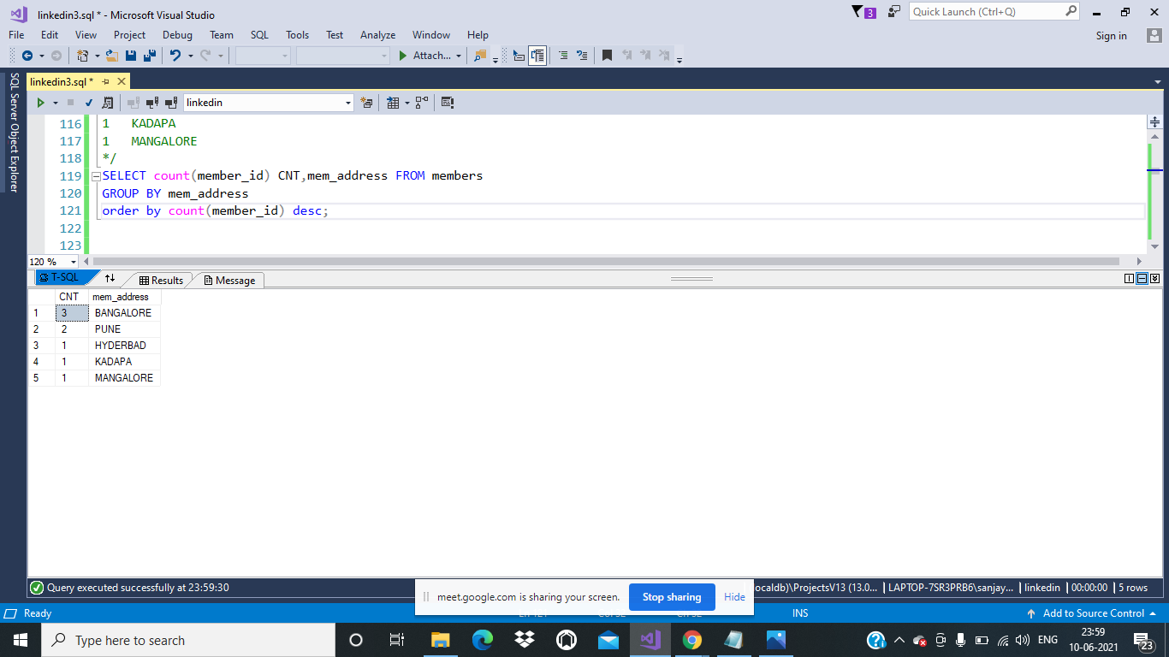
QUERY 9. WRITE A QUERY TO FETCH THE COUNT OF MEMBERS WHO ARE WORKING IN EACH LOCATION USING ORDER BY.
QUERY :-
SELECT COUNT(MEMBER_ID) CNT,MEM_ADDRESS FROM MEMBERS
GROUP BY MEM_ADDRESS
ORDER BY COUNT(MEMBER_ID) DESC;
OUTPUT :-

Slide 24
QUERY 9. WRITE A QUERY TO FETCH THE COUNT OF MEMBERS WHO ARE WORKING IN EACH LOCATION USING GROUP BY.
QUERY :-
SELECT COUNT(MEMBER_ID) CNT,MEM_ADDRESS FROM MEMBERS
GROUP BY MEM_ADDRESS
ORDER BY COUNT(MEMBER_ID) DESC;
OUTPUT :-

Slide 25
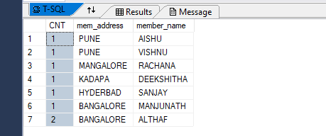
QUERY 10. WRITE A QUERY TO FETCH THE MEMBER ADDRESS AND MEMBER NAME WHO ARE WORKING FOR SAME LOCATION IN DESCENDING ORDER.
QUERY :-
SELECT COUNT(MEMBER_ID) CNT,MEM_ADDRESS,MEMBER_NAME FROM MEMBERS
GROUP BY MEM_ADDRESS,MEMBER_NAME
ORDER BY COUNT(MEMBER_ID),MEM_ADDRESS DESC;
OUTPUT :-

Slide 26
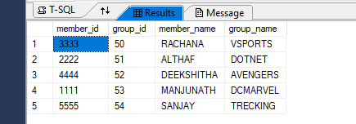
QUERY 11. WRITE A QUERY TO ACCESS THE GROUP_ID,MEMBER_ID, MEMBER_NAME AND GROUP_NAME TO WHICH MEMBER BELONGS TO WHICH GROUP USING FILTER CONDITION.
QUERY :-
SELECT M.MEMBER_ID,G.GROUP_ID,M.MEMBER_NAME,G.GROUP_NAME
FROM MEMBERS M,GROUPS G
WHERE M.MEMBER_ID=G.CREATED_BY_MEMBER_ID;
OUTPUT :-

Slide 27
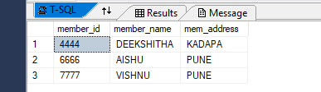
QUERY 12. WRITE A QUERY TO ACCESS THE MEMBER_ID, MEMBER_NAME AND MEMBER_ADDRESS WHO ARE BORNED BETWEEN JAN 1999 TO DEC 1999 USING BETWEEN OPERATOR.
QUERY :-
SELECT MEMBER_ID,MEMBER_NAME,MEM_ADDRESS
FROM MEMBERS WHERE DOB BETWEEN '01-JAN-1999' AND '30-DEC-1999';
OUTPUT :-

Slide 28
Queries : 13 to 18 by DEEKSHITA A
Groups & members_group table

Slide 29
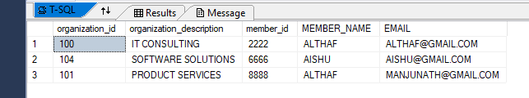
QUERY 13. WRITE A QUERY TO ACCESS THE OGRANIZATION_ID, OGRANIZATION_DESCRIPTION, MEMBER_ID, MEMBER_NAME WHO’S NAME STARTS WITH LETTER ‘A’ USING LIKE OPERATOR.
QUERY :-
SELECT O.ORGANIZATION_ID,O.ORGANIZATION_DESCRIPTION,M.MEMBER_ID,M.MEMBER_NAME,M.EMAIL
FROM ORGANIZATION O INNER JOIN MEMBERS M ON MEMBER_NAME LIKE ('A%') AND O.ORGANIZATION_ID=M.ORGANIZATION_ID
OUTPUT :-

Slide 30
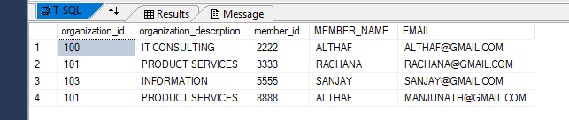
QUERY 14. WRITE A QUERY TO ACCESS THE OGRANIZATION_ID, OGRANIZATION_DESCRIPTION, MEMBER_ID, MEMBER_NAME WHO’S NAME HAVING 5TH LETTER ‘A’ USING LIKE OPERATOR.
QUERY :-
SELECT O.ORGANIZATION_ID,O.ORGANIZATION_DESCRIPTION,M.MEMBER_ID,M.MEMBER_NAME,M.EMAIL
FROM ORGANIZATION O INNER JOIN MEMBERS M ON MEMBER_NAME LIKE ('____A%') AND O.ORGANIZATION_ID=M.ORGANIZATION_ID
OUTPUT :-

Slide 31
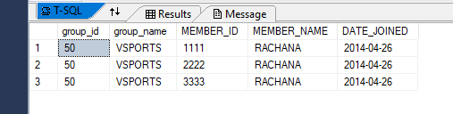
QUERY 15. WRITE A QUERY TO FETCH GROUP_NAME , MEMBER_NAME,DATE_JOINED WHO ARE BELONGS TO SAME GROUP.
QUERY :-
SELECT G.GROUP_ID,G.GROUP_NAME,M.MEMBER_ID,M1.MEMBER_NAME,M.DATE_JOINED
FROM GROUPS G INNER JOIN MEMBERS_GROUPS M ON G.GROUP_ID=M.GROUP_ID
INNER JOIN MEMBERS M1 ON G.CREATED_BY_MEMBER_ID=M1.MEMBER_ID
WHERE G.GROUP_NAME='VSPORTS';
OUTPUT :-

Slide 32
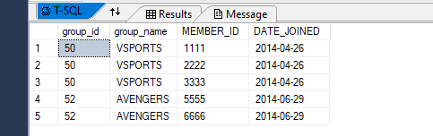
QUERY 16. WRITE A QUERY TO FETCH GROUP_NAME, MEMBER_NAME,DATE_JOINED WHO ARE BELONGS TO VSPORTS AND AVENGERS GROUP USING IN OPERATOR.
QUERY :-
SELECT G.GROUP_ID,G.GROUP_NAME,M.MEMBER_ID,M.DATE_JOINED
FROM GROUPS G INNER JOIN MEMBERS_GROUPS M ON G.GROUP_ID=M.GROUP_ID
WHERE G.GROUP_NAME IN('VSPORTS','AVENGERS');
OUTPUT :-

Slide 33
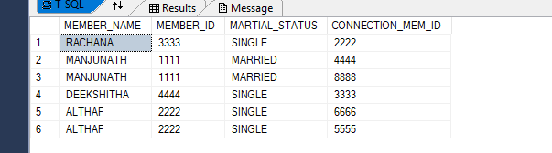
QUERY 17. WRITE A QUERY TO DISPALY MEMBER_ID, MEMBER_NAME,MARTIAL_STATUS AND CONNECTION_MEM_ID TO SEE HOW MANY CONNECTIONS A MEMBER HAVE, NAMES IN DESCENDING ORDER.
QUERY :-
SELECT M.MEMBER_NAME,M.MEMBER_ID,M.MARTIAL_STATUS,C.CONNECTION_MEM_ID
FROM MEMBERS M,CONNECTIONS C
WHERE M.MEMBER_ID=C.MEMBER_ID
ORDER BY (MEMBER_NAME)DESC;
OUTPUT :-

Slide 34
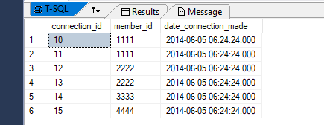
QUERY 18. WRITE A QUERY TO DISPLAY CONNECTION_ID, MEMBER_ID AND TO OBSERVE THE DATE OF WHEN CONNECTION HAS MADE.
QUERY :-
SELECT C.CONNECTION_ID,M.MEMBER_ID,C.DATE_CONNECTION_MADE
FROM CONNECTIONS C,MEMBERS M WHERE C.MEMBER_ID=M.MEMBER_ID;
OUTPUT :-

Slide 35
Queries : 19 to 24 by ALTHAF S
Posts table

Slide 36
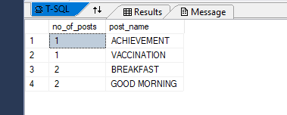
QUERY 19. WRITE A QUERY TO FIND HOW MANY POSTS ARE POSTED IN EACH POST_NAME USING GROUP BY AND HAVING CLUASE.
QUERY :-
SELECT COUNT(DATE_POSTED) AS NO_OF_POSTS ,POST_NAME
FROM POSTS GROUP BY POST_NAME HAVING COUNT(DATE_POSTED)>=1 ORDER BY NO_OF_POSTS ASC;
OUTPUT :-

Slide 37
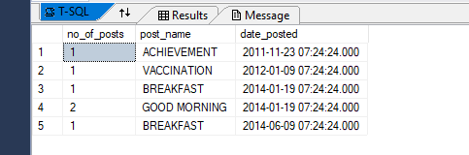
QUERY 20. WRITE A QUERY TO FIND HOW MANY POSTS ARE POSTED ON THE PARTICULAR DATE USING GROUP BY CLUASE.
QUERY :-
SELECT COUNT(DATE_POSTED) AS NO_OF_POSTS ,POST_NAME,DATE_POSTED
FROM POSTS GROUP BY POST_NAME,DATE_POSTED;
OUTPUT :-

Slide 38

QUERY 21. WRITE A QUERY TO DISPLAY FIRST FIVE RECORDS USING TOP KEYWORD.
QUERY :-
SELECT TOP 5 MEMBER_ID,MEMBER_NAME,MEM_ADDRESS,GENDER FROM MEMBERS;
OUTPUT :-

Slide 39
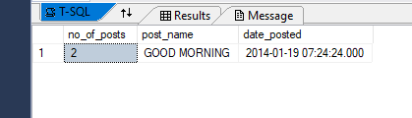
QUERY 22. WRITE A QUERY TO FETCH MAX NO OF POSTS POSTED USING SAME POST NAME.
QUERY :-
SELECT COUNT(DATE_POSTED) AS NO_OF_POSTS ,POST_NAME,DATE_POSTED
FROM POSTS GROUP BY POST_NAME,DATE_POSTED
HAVING DATE_POSTED='2014-JAN-19 07:24:24.000' AND POST_NAME='GOOD MORNING';
OUTPUT :-

Slide 40
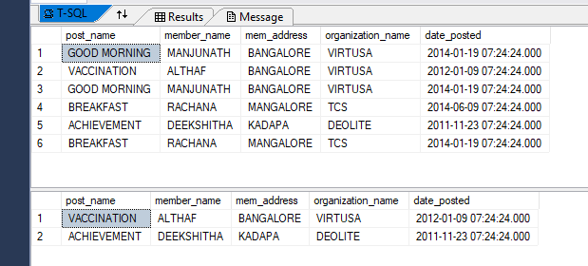
QUERY 23. WRITE A QUERY TO FETCH MEM_NAME, MEM_ADDS, ORG_NAME OF A MEMBER WHO HAVE POSTED A POST BEFORE 2014.
QUERY :-
SELECT P.POST_NAME,M.MEMBER_NAME,M.MEM_ADDRESS,O.ORGANIZATION_NAME,P.DATE_POSTED
FROM POSTS P INNER JOIN MEMBERS M ON P.POST_MEMBER_ID=M.MEMBER_ID
INNER JOIN ORGANIZATION O ON O.ORGANIZATION_ID=M.ORGANIZATION_ID;
SELECT P.POST_NAME,M.MEMBER_NAME,M.MEM_ADDRESS,O.ORGANIZATION_NAME,P.DATE_POSTED
FROM POSTS P INNER JOIN MEMBERS M ON P.POST_MEMBER_ID=M.MEMBER_ID
INNER JOIN ORGANIZATION O ON O.ORGANIZATION_ID=M.ORGANIZATION_ID
WHERE P.DATE_POSTED<'2014-JAN-09 07:24:24.000';
OUTPUT :-

Slide 41
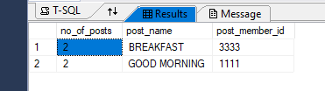
QUERY 24. WRITE A QUERY TO DISPALY POST_NAME, MEMBER_ID OF MEMBERS WHO HAVE POSTED MORE THAN ONE POST.
QUERY :-
SELECT COUNT(POST_MEMBER_ID) AS NO_OF_POSTS,POST_NAME ,POST_MEMBER_ID
FROM POSTS P
GROUP BY POST_MEMBER_ID,POST_NAME HAVING COUNT(POST_MEMBER_ID)>1;
OUTPUT :-

Slide 42
Queries : 25 to 31 by MANJUNATH T
Connections & members_profile table

Slide 43
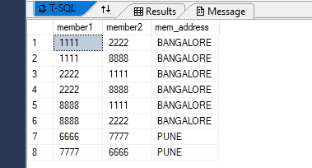
QUERY 25. WRITE A QUERY TO SELECT ALL MEMBERS WHO ARE FROM SAME PLACE USING SELF JOIN.
QUERY :-
SELECT A.MEMBER_ID AS MEMBER1,B.MEMBER_ID MEMBER2,A.MEM_ADDRESS
FROM MEMBERS A,MEMBERS B WHERE A.MEM_ADDRESS=B.MEM_ADDRESS AND A.MEMBER_ID!=B.MEMBER_ID ORDER BY A.MEM_ADDRESS;
OUTPUT :-

Slide 44
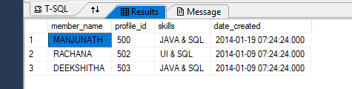
QUERY 26. WRITE A QUERY TO DISPLAY WHO HAVE PROFILES IN LINKEDIN HAVING JAVA-SQL AND UI-SQL SKILLS.
QUERY :-
SELECT M.MEMBER_NAME,P.PROFILE_ID,P.SKILLS,P.DATE_CREATED
FROM MEMBERS M,MEMBER_PROFILE P WHERE M.MEMBER_ID=P.PROFILE_MEMBER_ID AND SKILLS IN('JAVA & SQL','UI & SQL');
OUTPUT :-

Slide 45
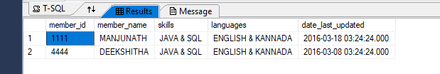
QUERY 27. WRITE A QUERY TO RETRIEVE DETAILS OF A PERSON WHO KNOWS ENGLISH AND KANNADA LANGUAGES.
QUERY :-
SELECT M.MEMBER_ID,M.MEMBER_NAME,P.SKILLS,P.LANGUAGES,P.DATE_LAST_UPDATED
FROM MEMBERS M,MEMBER_PROFILE P WHERE M.MEMBER_ID=P.PROFILE_MEMBER_ID AND LANGUAGES='ENGLISH & KANNADA';
OUTPUT :-

Slide 46
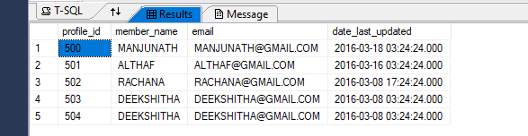
QUERY 28. WRITE A QUERY TO DISPLAY PROFILE_ID, MEMBER_NAME, EMAIL AND WHEN PROFILE LAST UPDATED DATE AND TIME.
QUERY :-
SELECT P.PROFILE_ID,M.MEMBER_NAME,M.EMAIL,P.DATE_LAST_UPDATED
FROM MEMBER_PROFILE P,MEMBERS M WHERE P.PROFILE_MEMBER_ID=M.MEMBER_ID;
OUTPUT :-

Slide 47
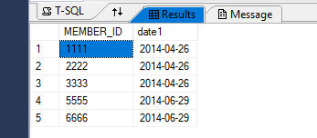
QUERY 29. WRITE A QUERY TO DISPLAY WHO JOINED ON SAME DATE TO THE GROUP USING DISTINCT KEYWORD.
QUERY :-
SELECT DISTINCT A.MEMBER_ID,A.DATE_JOINED AS DATE1
FROM MEMBERS_GROUPS A,MEMBERS_GROUPS B WHERE A.DATE_JOINED=B.DATE_JOINED AND A.MEMBER_ID!=B.MEMBER_ID;
OUTPUT :-

Slide 48
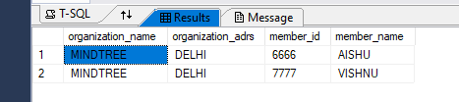
QUERY 30. WRITE A QUERY TO DISPLAY MEMBER DETAILS WHO ARE WORKING FOR MINDTREE.
QUERY :-
SELECT O.ORGANIZATION_NAME,O.ORGANIZATION_ADRS,M.MEMBER_ID,M.MEMBER_NAME
FROM MEMBERS M,ORGANIZATION O WHERE M.ORGANIZATION_ID=O.ORGANIZATION_ID AND O.ORGANIZATION_NAME='MINDTREE';
OUTPUT :-

Slide 49
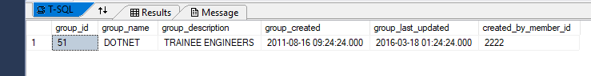
QUERY 31. WRITE A QUERY TO DISPLAY GROUP DETAILS WHERE GROUP_DESCRIPTION HAVING TWO CONSECUTIVE E’S.
QUERY :-
SELECT * FROM GROUPS WHERE GROUP_DESCRIPTION LIKE '%EE%';
OUTPUT :-

Slide 50


